Slide 1
Monolithic 3D DRAM Technology
Deepak C. Sekar, Brian Cronquist, Israel Beinglass, Paul Lim, Zvi Or-Bach
15th June 2011
MonolithIC 3D Inc. Patents Pending

Slide 2
Outline
Status of the DRAM industry today
Monolithic 3D DRAM
Implications and risks of the technology
Summary

Slide 3
Outline
Status of the DRAM industry today
Monolithic 3D DRAM
Implications of the technology
Summary

Slide 4
DRAM makers fall in the “endangered species” category
1996
24 key DRAM players
2010
9 key DRAM players
Samsung Hyundai
Micron Siemens
NEC Hitachi
Mitsubishi Toshiba
Fujitsu LG Semicon
TI-Acer Vanguard
Powerchip ProMOS
Winbond Oki
IBM TI
Motorola Matsushita
Seiko Epson Nippon Steel
UMC Mosel Vitelic
Samsung
Hynix
Micron
Elpida
Nanya
Inotera
Powerchip
ProMOS
Winbond
Why? What are the challenges? We’ll see in the next few slides

Slide 5
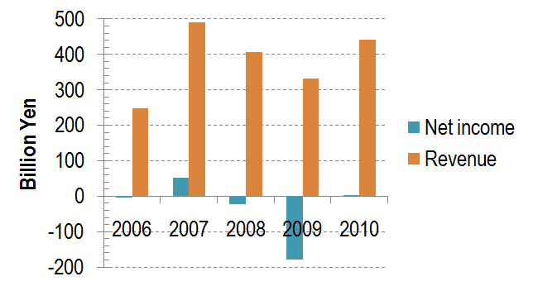
Reason 1: Profitability
Financials of a top-tier DRAM vendor (Elpida) vs. fiscal year
DRAM has not been a profitable business in the near past
Balance sheets of most companies’ DRAM businesses similar to above ☹

Slide 6
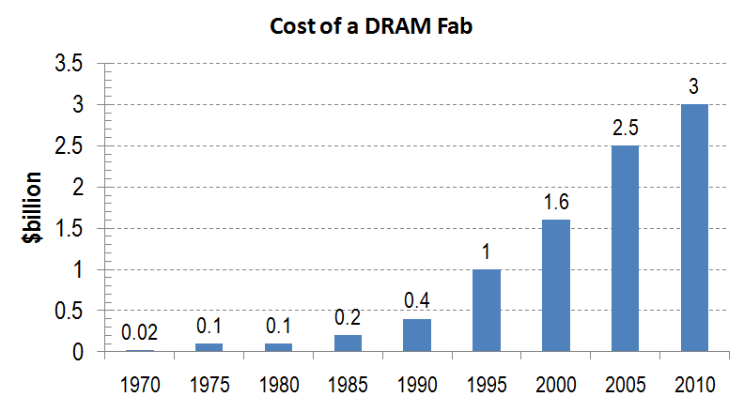
Reason 2: Large fab cost for scaling-down
Source: Morgan Stanley
Today,
Litho Tool Cost = $42M
Etch, CVD, Implant, RTA tools each cost <$5M
Scaling-down → lower cost per bit → but huge litho and fab investment
Hard for unprofitable companies to fund scaled-down fabs

Slide 7
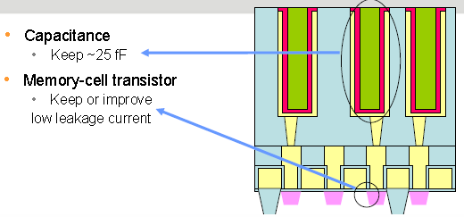
Reason 3: Scaling-down the stacked capacitor challenging
Capacitance
Keep ~25fF
Memory Cell Transistor
Keep low leakage current
Al₂O₃ (90nm) → HfO₂ (80nm)
→ ZrO₂ (60nm) → ?
 | 45nm | 32nm | 22nm | 15nm | 10nm
Dielectric constant | 40 | 50 | 60 | 65 | 70
Aspect ratio | 47:1 | 56:1 | 99:1 | 147:1 | 193:1
EOT | 0.8nm | 0.6nm | 0.5nm | 0.3nm | 0.2nm
Source: ITRS 2010
Requires >150:1 aspect ratios and exotic new high-k dielectrics!

Slide 8
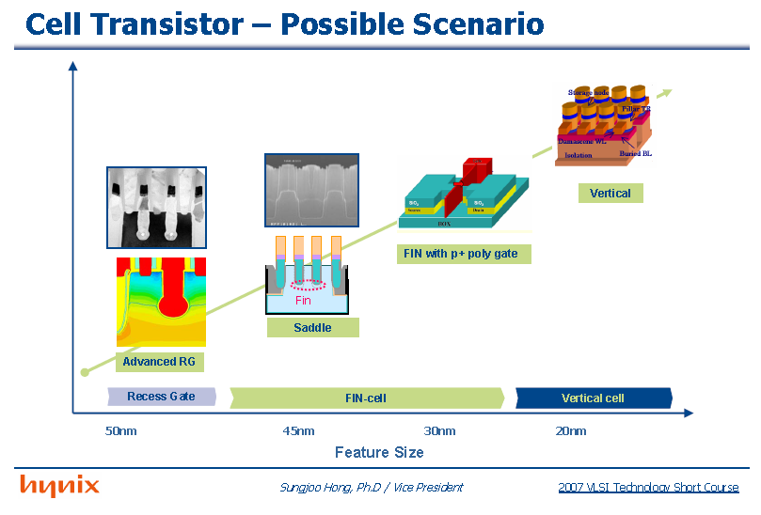
Reason 4: The cell transistor needs major updates on scaling-down
A major new transistor every generation or two!
100nm Planar → 80nm RCAT → 60nm S-RCAT → 35nm Finfet (?) → 20nm Vertical (?)

Slide 9
To recap, Things don’t look good for DRAM vendors because
Low profitability
Cost of scaled-down fabs
Scaling-down stacked capacitor
Cell transistor scaling-down
Related
Common theme → Scaling-down
Is there an alternative way to reduce DRAM bit cost other than scaling-down?
Focus of this presentation

Slide 10
Outline
Status of the DRAM industry today
Monolithic 3D DRAM
Implications of the technology
Summary

Slide 11
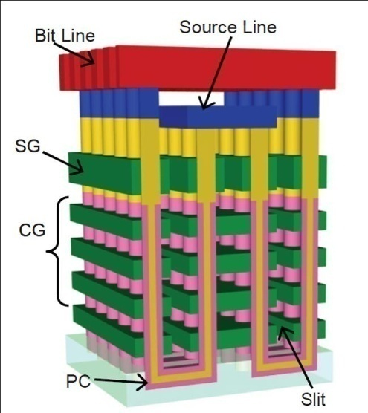
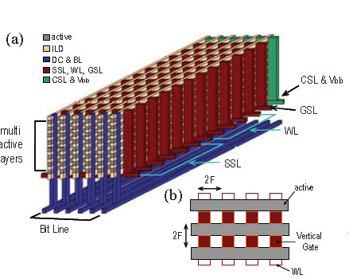
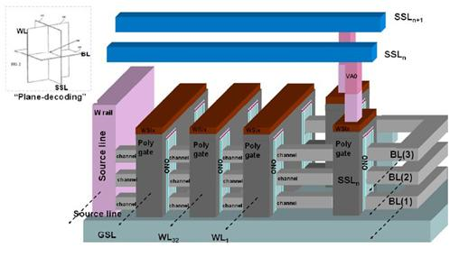
Key technology direction for NAND flash: Monolithic 3D with shared litho steps for memory layers
Toshiba BiCS
Poly Si
Samsung VG-NAND
Poly Si
Macronix junction-free NAND
Poly Si
To be viable for DRAM, we require
Single-crystal silicon at low thermal budget → Charge leakage low
Novel monolithic 3D DRAM architecture with shared litho steps

Slide 12
Single crystal Si at low thermal budget
Obtained using the ion-cut process. It’s use for SOI shown above.
Ion-cut used for high-volume manufacturing SOI wafers for 10+ years.
Hydrogen implant
of top layer
Flip top layer and
bond to bottom layer
Cleave using 400ºC
anneal or sideways
mechanical force. CMP.
Oxide
Activated p Si
Oxide
H
Top layer
Activated p Si
Activated p Si
Top layer
Activated p Si
H
Oxide
Oxide
Oxide
Silicon
Silicon
Silicon
Bottom layer

Slide 13
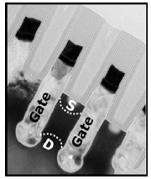
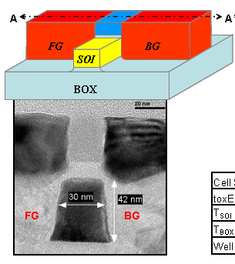
Double-gated floating body memory cell well-studied in Silicon (for 2D-DRAM)
Hynix + Innovative Silicon
VLSI 2010
Intel
IEDM 2006
0.5V, 55nm channel length
900ms retention
Bipolar mode
2V, 85nm channel length
10ms retention
MOSFET mode

Slide 14
Our novel DRAM architecture
Innovatively combines these well-studied technologies
Monolithic 3D with litho steps shared among multiple memory layers
Stacked Single crystal Si with ion-cut
Double gate floating body RAM cell (below) with charge stored in body
Gate Electrode
n+
Gate Dielectric
p
n+
n+
SiO₂

Slide 15
Process Flow: Step 1 Fabricate peripheral circuits followed by silicon oxide layer
Silicon Oxide
Peripheral circuits with W wiring

Slide 16
Process Flow: Step 2 Transfer p Si layer atop peripheral circuit layer
H implant
Silicon Oxide
p Silicon
Top layer
H implant
p Silicon
Flip top layer and bond to bottom layer
Silicon Oxide
Silicon Oxide
Silicon Oxide
Peripheral circuits
Peripheral circuits
Bottom layer

Slide 17
Process Flow: Step 3 Cleave along H plane, then CMP
Silicon Oxide
p Silicon
Peripheral circuits
Silicon Oxide
Silicon Oxide
Peripheral circuits

Slide 18
Process Flow: Step 4 Using a litho step, form n+ regions using implant
n+
p
n+
p
n+
Silicon Oxide
Silicon Oxide
Peripheral circuits

Slide 19
Process Flow: Step 5 Deposit oxide layer
Silicon Oxide
n+
Silicon Oxide
Silicon Oxide
Peripheral circuits
p

Slide 20
Process Flow: Step 6 Using methods similar to Steps 2-5, form multiple Si/SiO₂ layers, RTA
Silicon Oxide 06
Silicon Oxide 06
Silicon Oxide 06
Silicon Oxide
n+
p
n+
Silicon Oxide
Silicon Oxide
Silicon Oxide
Peripheral circuits

Slide 21
Process Flow: Step 7 Use lithography and etch to define Silicon regions
This n+ Si region will act as wiring for the array… details later
Silicon Oxide 06
Silicon Oxide 06
Silicon Oxide 06
Silicon Oxide 06
Silicon Oxide 06
Silicon Oxide 06
Silicon Oxide 06
Silicon Oxide 06
Silicon Oxide
Peripheral circuits
Symbols
p Silicon
Silicon oxide
n+ Silicon

Slide 22
Process Flow: Step 8 Deposit gate dielectric, gate electrode materials, CMP, litho and etch
Silicon Oxide 06
Silicon Oxide 06
Silicon Oxide 06
Silicon Oxide 06
Silicon Oxide 06
Silicon Oxide 06
Silicon Oxide 06
Silicon Oxide 06
Silicon Oxide
Peripheral circuits
Symbols
n+ Silicon
Gate electrode
Silicon oxide
Gate dielectric

Slide 23
Process Flow: Step 9 Deposit oxide, CMP. Oxide shown transparent for clarity.
Word Line (WL)
Silicon oxide
WL current path
Silicon Oxide 06
Silicon Oxide 06
Silicon Oxide 06
SL current path
Silicon Oxide 06
Silicon Oxide 06
Silicon Oxide 06
Silicon Oxide 06
Silicon Oxide 06
Silicon Oxide
Peripheral circuits
Source-Line (SL)
Symbols
Gate dielectric
Silicon oxide
n+ Silicon
Gate electrode
Silicon oxide

Slide 24
Process Flow: Step 10 Make Bit Line (BL) contacts that are shared among various layers.
WL
Silicon oxide
BL contact
WL current path
Silicon Oxide 06
Silicon Oxide 06
Silicon Oxide 06
SL current path
Silicon Oxide 06
Silicon Oxide 06
Silicon Oxide 06
Silicon Oxide 06
Silicon Oxide 06
Silicon Oxide
Peripheral circuits
SL
Symbols
Gate dielectric
Silicon oxide
n+ Silicon
BL contact
Gate electrode
Silicon oxide

Slide 25
Process Flow: Step 11 Construct BLs, then contacts to BLs, WLs and SLs at edges of memory array using methods in [Tanaka, et al., VLSI 2007]
WL
BL
Silicon Oxide 06
BL current
Silicon Oxide 06
Silicon Oxide 06
Silicon Oxide 06
WL current
SL current
Silicon Oxide 06
Silicon Oxide 06
Silicon Oxide 06
Silicon Oxide 06
Silicon Oxide
Peripheral circuits
SL
Symbols
Gate dielectric
Silicon oxide
n+ Silicon
BL
BL contact
Gate electrode
Silicon oxide

Slide 26
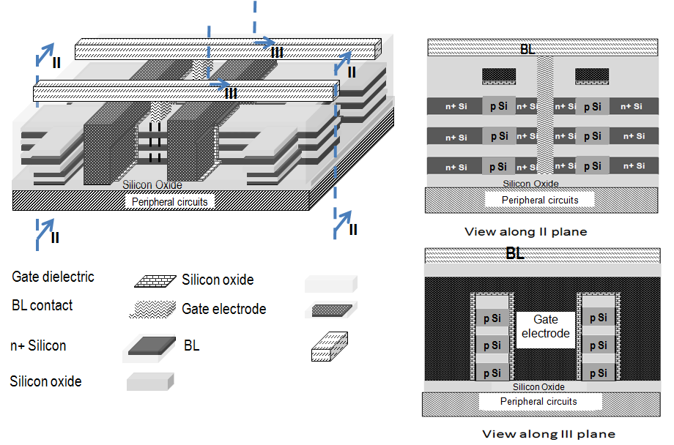
Some cross-sectional views for clarity. Each floating-body cell has unique combination of BL, WL, SL

Slide 27
A different implementation: With independent double gates
SL
BL
Silicon Oxide 06
Silicon Oxide 06
Silicon Oxide 06
Silicon Oxide 06
Silicon Oxide 06
Silicon Oxide 06
Silicon Oxide 06
Silicon Oxide 06
WL
p Silicon
n+ Silicon
WL wiring
Gate electrode
BL
Silicon oxide
Periphery
BL contact
Gate dielectric

Slide 28
Outline
Status of the DRAM industry today
Monolithic 3D DRAM
Implications and risks of the technology
Summary

Slide 29
Density estimation
 | Conventional stacked capacitor DRAM | Monolithic 3D DRAM with 4 memory layers
Cell size | 6F² | Since non self-aligned, 7.2F²
Density | x | 3.3x
Number of litho steps | 26 (with 3 stacked cap. masks) | ~26 (3 extra masks for memory layers, but no stacked cap. masks)
3.3x improvement in density vs. standard DRAM, but similar number of critical litho steps!!!
Negligible prior work in Monolithic 3D DRAM with shared litho steps, poly Si 3D doesn’t work for DRAM (unlike NAND flash) due to leakage

Slide 30
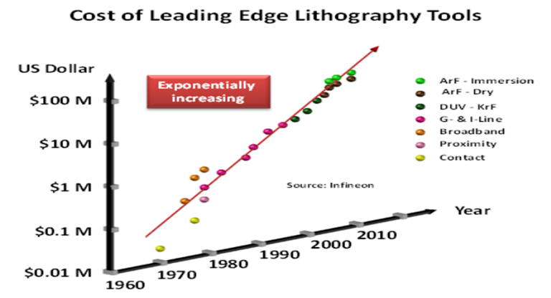
Scalability
Multiple generations of cost per bit improvement possible
(eg) 22nm 2D →
22nm 3D 2 layers →
22nm 3D 4 layers → ...
Use same 22nm litho tools for 6+ years above. Tool value goes down 50% every 2 years → Cheap ☺
Avoids cost + risk of next-gen litho

Slide 31
Reduces or avoids some difficulties with scaling-down
EUV delays and risk
Capacitor manufacturing
(EETimes 2002)
"EUV to be in production in 2007"
(EETimes 2003)
"EUV to be leading candidate for the 32nm node in 2009"
(EETimes 2004)
"EUV to be pushed out to 2013"
(EETimes 2010)
"EUV late for 10nm node milestone in 2015"
 | 45nm | 32nm | 22nm | 15nm | 10 nm
ε | 40 | 50 | 60 | 65 | 70
AR | 47 | 56 | 99 | 147 | 193
Continuous transistor updates
Planar → RCAT → S-RCAT → Finfet
→ Vertical devices

Slide 32
Risks
Floating-body RAM
Retention, reliability, smaller-size devices, etc
Cost of ion-cut
Supposed to be <$50-75 per layer since one implant, bond, cleave, CMP step. But might require optimization to reach this value.

Slide 33
Outline
Status of the DRAM industry today
Monolithic 3D DRAM
Implications and risks of the technology
Summary

Slide 34
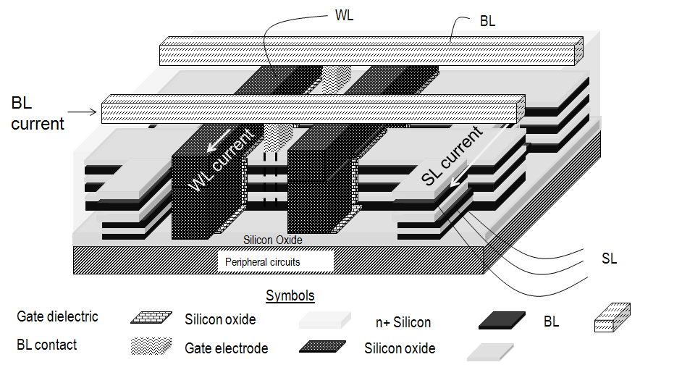
Summary of Monolithic 3D DRAM Technology
Monolithic 3D with shared litho steps
Single crystal Si
Floating body RAM
Under development...
3.3x density of conventional DRAM, but similar number of litho steps
Scalable (eg) 22nm 2D → 22nm 3D 2 layers → 22nm 3D 4 layers → ...
Cheap depreciated tools, less litho cost + risk, avoids many cap. & transistor upgrades
Risks = Floating body RAM, ion-cut cost

Slide 35
Backup slides

Slide 36
A note on overlay
Implant n+ in p Si regions layer-by-layer, then form gate
→ non self-aligned process
ITRS <20% overlay requirement
ASML 1950i = 3.5nm overlay for 38nm printing. <10% overlay.
So, gate length = 1.2F. Penalty of 0.2F for non-self-aligned process

Slide 37
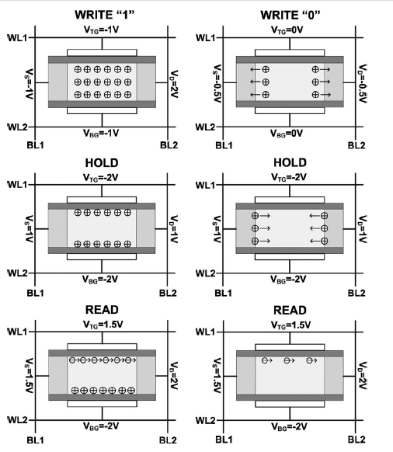
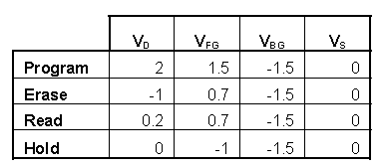
Bias schemes for floating body RAM
Bipolar Mode [S. Alam, et al, TED 2010]
MOS Mode [Intel, IEDM 2006]

Slide 38
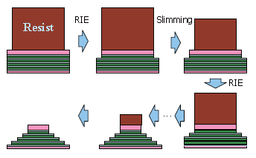
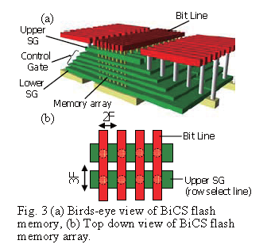
Contact processing with shared litho steps
Similar to Toshiba BiCS scheme [VLSI 2007]

