Slide 1

The Monolithic 3D-IC
A Disruptor to the Semiconductor Industry

Slide 2

Monolithic 3D Provides an Attractive Path to…
LOGIC
MEMORY
OPTO-ELECTRONICS
Monolithic 3D Integration with Ion-Cut Technology
3D-CMOS: Monolithic 3D Logic Technology
3D-FPGA: Monolithic 3D Programmable Logic
3D-GateArray: Monolithic 3D Gate Array
3D-Repair: Yield recovery for high-density chips
3D-Flash: Monolithic 3D Flash Memory
3D-DRAM: Monolithic 3D DRAM
3D-RRAM: Monolithic 3D RRAM
3D-Imagers: Monolithic 3D Image Sensor
3D-MicroDisplay: Monolithic 3D Display
Can be applied to many market segments

Slide 3

Layer Transfer Technology
(or “Ion-Cut” / “Smart-Cut”)→ The Technology Behind SOI
Cleave using 400ºC
anneal or sideways
mechanical force. CMP.
Hydrogen implant
of top layer
Flip top layer and
bond to bottom layer
Oxide
p- Si
Top layer
Oxide
H
p- Si
H
p- Si
p- Si
Oxide
Oxide
Oxide
Oxide
Oxide
Bottom layer
Similar process (bulk-to-bulk) used for manufacturing all SOI wafers today

Slide 4
Monolithic 3D NAND Flash
4x density of conventional NAND Flash, at similar number of litho steps (cost)

Slide 5
Preview
Non-volatile memory companies → Are now going for monolithic 3D
MonolithIC 3DTM Inc.: Offers mono-crystal monolithic 3D solutions
Industry → Largely poly Si 3D memory (Toshiba BiCS, Samsung VG-NAND,…)
MonolithIC 3DTM Inc.: → Single crystal Si 3D memory
NuFlash
4x density improvement vs. NAND, with similar number of litho steps
NuRRAM
2x density improvement vs. NAND, with similar number of litho steps
1 million cycles, higher performance

Slide 6
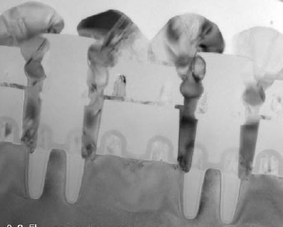
Ion-cut vs. other types of stacked Si
 | Poly Si with RTA | Selective epi Si | Ion-cut Si
Defect density | High | Low, but cracks exist. | Perfect single crystal Si.
Mobility | 100cm²/Vs |  | 650cm²/Vs
Variability | High |  | Low
Sub-threshold slope and Leakage | High |  | Low
Temperature stacked bottom layer exposed to typically | 700-800ºC for crystallization | ~700ºC | <400ºC
Cost | Low |  | See next slide

Slide 7
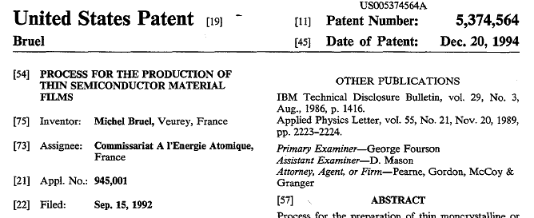
Ion-cut is Simple and Not Expensive Process
Industry sources → <$50 cost per wafer (ion cut = implant, bond, anneal).
Free market scenario → SOITEC basic patent had expired on Sept. 2012
Contents:
Hydrogen implant
Cleave with anneal

Slide 8
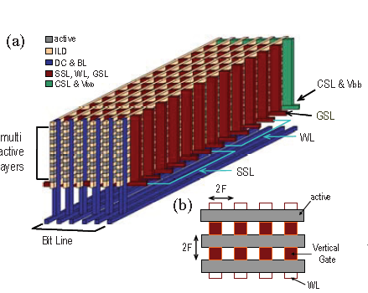
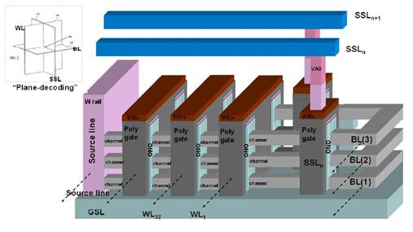
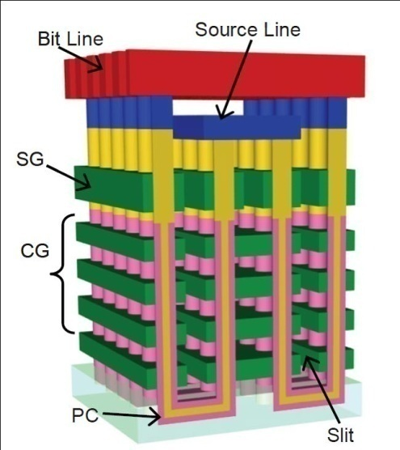
3D NAND Using Poly are The Next Generation
Toshiba BiCS
Vertical, poly Si
Samsung VG-NAND
Horizontal, poly Si
Macronix junction-free-NAND
Horizontal, poly Si
Poly Si → low mobility, high variation, large S-factor → this, coupled with charge-trap nature makes MLC 3D NAND very difficult!!!

Slide 9
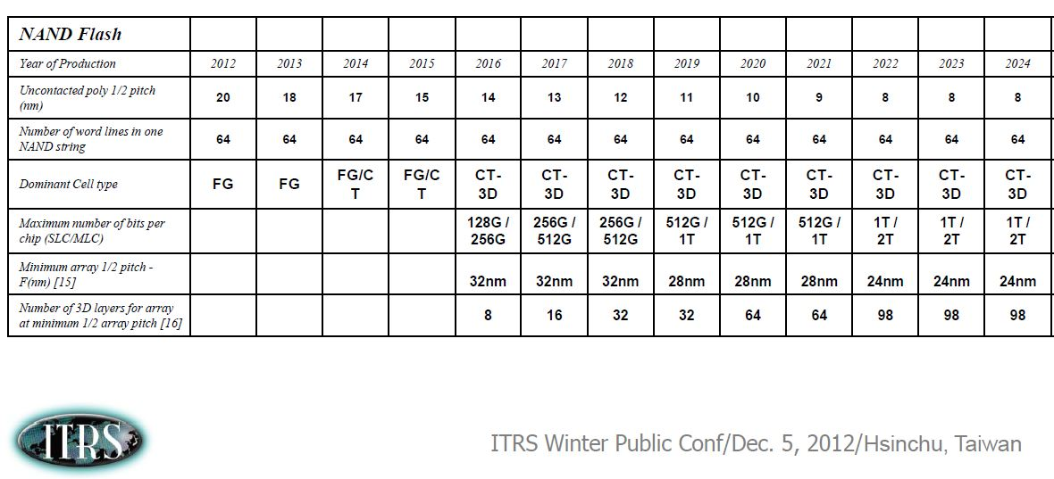
ITRS 2012 – NAND Flash Adapting Monolithic 3D

Slide 10
Monolithic 3D NAND – Crystallized Si Base
Any horizontally oriented 3D NAND Implementation
→ can be constructed with single crystal Silicon using ion-cut
Sub-400ºC process, avoid complications with poly-Si

Slide 11
NuFlash Memory Cell
CG
n+
ONO layer 1
ONO layer 2
n+
n+
SiO₂
CG
Double gate single-crystal Si cell
Fully-depleted device
Two charge trap layers per cell

Slide 12
Process Flow: Step 1
Fabricate peripheral circuits followed by silicon oxide layer
Silicon Oxide
Peripheral circuits

Slide 13
Process Flow: Step 2
Transfer n+ Si layer atop peripheral circuit layer
H implant
Silicon Oxide
n+ Silicon
Top layer
H implant
n+ Silicon
Flip Top layer and bond to bottom layer
Silicon Oxide
Silicon Oxide
Silicon Oxide
Peripheral circuits
Peripheral circuits
Bottom layer

Slide 14
Process Flow: Step 3
Cleave, CMP, oxide deposition
Silicon Oxide
n+ Silicon
Silicon Oxide
Silicon Oxide
Peripheral circuits

Slide 15
Process Flow: Step 4
Form multiple Si layers
Silicon Oxide 06
Silicon Oxide 06
Silicon Oxide 06
Silicon Oxide
Silicon Oxide
n+ Silicon
Silicon Oxide
Silicon Oxide
Peripheral circuits

Slide 16
Process Flow: Step 5
Use litho and etch to define layers
Silicon Oxide 06
Silicon Oxide 06
Silicon Oxide 06
Silicon Oxide 06
Silicon Oxide 06
Silicon Oxide 06
Silicon Oxide 06
Silicon Oxide 06
Silicon Oxide
Peripheral circuits
Symbols
n+ Silicon
Silicon oxide

Slide 17
Process Flow: Step 6
Deposit gate dielectric, electrode, CMP, pattern and etch
NAND string
Select gates
Silicon Oxide 06
Silicon Oxide 06
Silicon Oxide 06
Silicon Oxide 06
Silicon Oxide 06
Silicon Oxide 06
Silicon Oxide 06
Silicon Oxide
Peripheral circuits
Symbols
n+ Silicon
Gate electrode 3724
Silicon oxide
Gate dielectric

Slide 18
Process Flow: Step 7
Oxide, CMP, form bit-lines, cell source regions
Wiring for select gates
Silicon oxide
Silicon Oxide 06
Silicon Oxide 06
Silicon Oxide 06
Silicon Oxide 06
WL
Silicon Oxide 06
Silicon Oxide 06
Silicon Oxide 06
Three Bit-Lines (BL) of n+ Si
Silicon Oxide
Peripheral circuits
Cell source regions
Gate dielectric
Silicon oxide
n+ Silicon
Gate electrode

Slide 19
MonolithIC Flash vs. Conventional NAND vs. BiCS
Estimates from 2010 VLSI Symposium short course on 3D Memory.
140 sq. mm die | Conventional NAND 22nm node | BiCS 32 layers @ 45nm node | NuFlash 8 layers @ 22nm node
Density | 64Gbit (MLC) | 128Gbit (SLC) 256Gbit (MLC) | 256Gbit (MLC)
Aspect ratio |  | 60:1 → hard to manufacture | 16:1
Scaling |  | Difficult, only scale up | Practical, scale up and sideways
MonolithIC Flash
4x improvement in density at similar number of litho steps

Slide 20
Monolithic 3D DRAM
3.3x density of conventional DRAM, at similar number of litho steps (cost)

Slide 21
Process Flow: Step 3
Cleave along H plane, then CMP
Silicon Oxide
p Silicon
Peripheral circuits
Silicon Oxide
Silicon Oxide
Peripheral circuits

Slide 22
Process Flow: Step 4
Using a litho step, form n+ regions using implant
n+
p
n+
p
n+
Silicon Oxide
Silicon Oxide
Peripheral circuits

Slide 23
Process Flow: Step 5
Deposit oxide layer
Silicon Oxide
n+
Silicon Oxide
Silicon Oxide
Peripheral circuits
p

Slide 24
Process Flow: Step 6
Using methods similar to Steps 2-5, form multiple Si/SiO₂ layers, RTA
Silicon Oxide 06
Silicon Oxide 06
Silicon Oxide 06
Silicon Oxide
n+
p
n+
p
n+
Silicon Oxide
Silicon Oxide
Silicon Oxide
Peripheral circuits

Slide 25
Process Flow: Step 7
Use lithography and etch to define Silicon regions
This n+ Si region will act as wiring for the array… details later
Silicon Oxide 06
Silicon Oxide 06
Silicon Oxide 06
Silicon Oxide 06
Silicon Oxide 06
Silicon Oxide 06
Silicon Oxide 06
Silicon Oxide 06
Silicon Oxide
Peripheral circuits
Symbols
p Silicon
Silicon oxide
n+ Silicon

Slide 26
Process Flow: Step 8
Deposit gate dielectric, gate electrode materials, CMP, litho and etch
Silicon Oxide 06
Silicon Oxide 06
Silicon Oxide 06
Silicon Oxide 06
Silicon Oxide 06
Silicon Oxide 06
Silicon Oxide 06
Silicon Oxide 06
Silicon Oxide
Peripheral circuits
Symbols
n+ Silicon
Gate electrode
Silicon oxide
Gate dielectric

Slide 27
Process Flow: Step 9
Deposit oxide, CMP. Oxide shown transparent for clarity.
Word Line (WL)
Silicon oxide
WL current path
Silicon Oxide 06
Silicon Oxide 06
Silicon Oxide 06
SL current path
Silicon Oxide 06
Silicon Oxide 06
Silicon Oxide 06
Silicon Oxide 06
Silicon Oxide 06
Silicon Oxide
Peripheral circuits
Source-Line (SL)
Symbols
Gate dielectric
Silicon oxide
n+ Silicon
Gate electrode
Silicon oxide

Slide 28
Process Flow: Step 10
Make Bit Line (BL) contacts that are shared among various layers.
WL
Silicon oxide
BL contact
WL current path
Silicon Oxide 06
Silicon Oxide 06
Silicon Oxide 06
SL current path
Silicon Oxide 06
Silicon Oxide 06
Silicon Oxide 06
Silicon Oxide 06
Silicon Oxide 06
Silicon Oxide
Peripheral circuits
SL
Symbols
Gate dielectric
Silicon oxide
n+ Silicon
BL contact
Gate electrode
Silicon oxide

Slide 29
Process Flow: Step 11
Construct BLs, then contacts to BLs, WLs and SLs at edges of memory array using methods in [Tanaka, et al., VLSI 2007]
WL
BL
Silicon Oxide 06
BL current
Silicon Oxide 06
Silicon Oxide 06
Silicon Oxide 06
WL current
SL current
Silicon Oxide 06
Silicon Oxide 06
Silicon Oxide 06
Silicon Oxide 06
Silicon Oxide
Peripheral circuits
SL
Symbols
Gate dielectric
Silicon oxide
n+ Silicon
BL
BL contact
Gate electrode
Silicon oxide

Slide 30
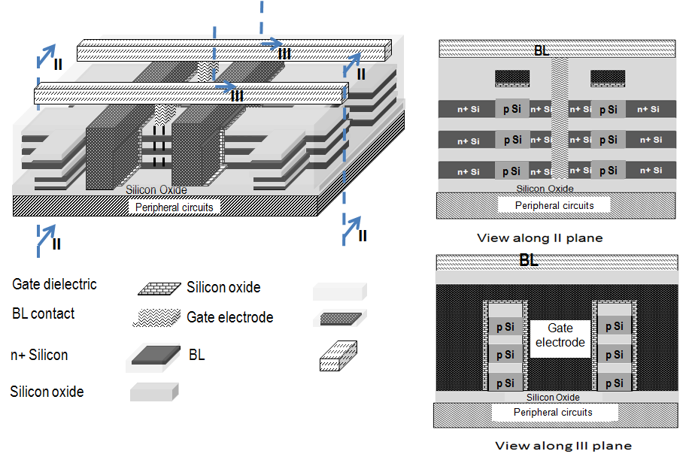
Some cross-sectional views for clarity. Each floating-body cell has unique combination of BL, WL, SL

Slide 31
Density estimation
 | Conventional stacked capacitor DRAM | Monolithic 3D DRAM with 4 memory layers
Cell size | 6F² | Since non self-aligned, 7.2F²
Density | x | 3.3x
Number of litho steps | 26 (with 3 stacked cap. masks) | ~26 (3 extra masks for memory layers, but no stacked cap. masks)
3.3x improvement in density vs. standard DRAM, but similar number of critical litho steps!!!
Negligible prior work in monolithic 3D DRAM with shared litho steps, poly Si 3D doesn’t work for DRAM (unlike NAND flash) due to leakage

Slide 32
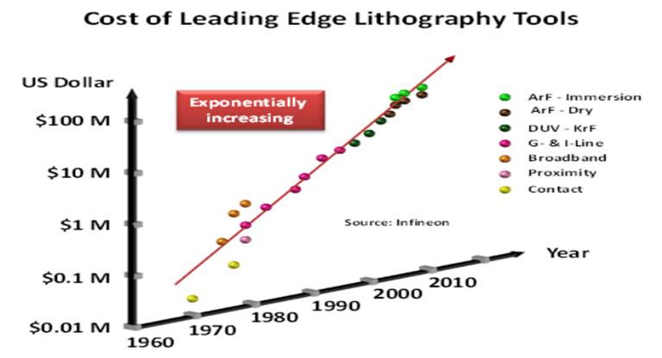
Scalability
MonolithIC 3D Inc. Patents Pending
32

Slide 33
Scalability
Multiple generations of cost per bit improvement possible
(e.g.) 22nm 2D →
22nm 3D 2 layers →
22nm 3D 4 layers → ...
Use same 22nm litho tools for 6+ years above. Tool value goes down 50% every 2 years → Cheap ☺
Avoids cost + risk of next-gen litho
MonolithIC 3D Inc. Patents Pending
33

Slide 34
Avoids the difficulties with scaling-down
EUV delays and risk
Capacitor manufacturing
(EETimes 2002)
"EUV to be in production in 2007"
(EETimes 2003)
"EUV to be leading candidate for the 32nm in 2009"
(EETimes 2004)
"EUV to be pushed out to 2013"
(EETimes 2010)
"EUV late for 10nm node milestone in 2015"
 | 45 nm | 32 nm | 22 nm | 15 nm | 10 nm
ε | 40 | 50 | 60 | 65 | 70
AR | 47 | 56 | 99 | 147 | 193
Continuous transistor updates
Planar → RCAT → S-RCAT → Finfet
→ Vertical devices
MonolithIC 3D Inc. Patents Pending
34

Slide 35
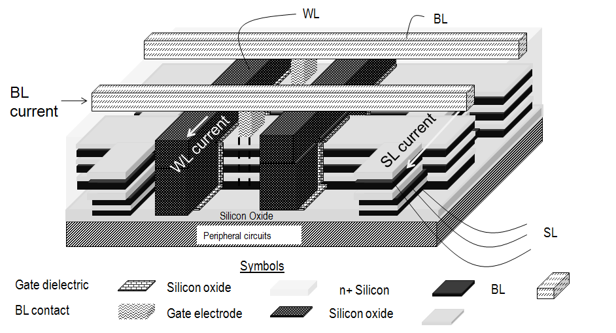
Summary of Monolithic 3D DRAM Technology
Monolithic 3D with shared litho steps
Single crystal Si
Floating body RAM
Under development...
3.3x density of conventional DRAM, at similar number of litho steps (cost)
Scalable (e.g.) 22nm 2D → 22nm 3D 2 layers → 22nm 3D 4 layers → ...
Cheap depreciated tools, less litho cost + risk
Avoids cap. & transistor upgrades challenges
MonolithIC 3D Inc. Patents Pending
35

Slide 36
Monolithic 3D R-RAM
2x density improvement vs. conventional NAND
1M cycles endurance, low latency, high performance
MonolithIC 3D Inc. Patents Pending
36

Slide 37
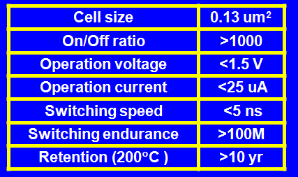
R-RAM: A Promising Next Generation Memory
Below data from IEDM 2009 for a (transistor + R-RAM ) → Promising
Well-known and simple materials (unlike PCM), low switching power, good endurance.
AlCu
TiN
Ti
HfO_{x}
TiN

Slide 38
Potential Architectures for Integrating RRAM into Arrays:
(1) Poly Si diode Selectors
Unidirectional current flow → bad for bipolar RRAM
Poly very leaky, low drive current vs. single crystal Si
→ bandwidth/power good for storage apps?
Diode RTA → W wiring, not Cu or Al.
p
n
RRAM
Matrix [ISSCC 2003]
Hitachi [VLSI 2009]

Slide 39
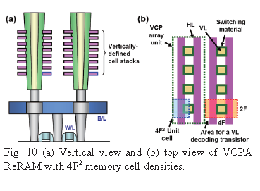
Potential Architectures for Integrating RRAM into Arrays:
(2) Transistor Selectors at Bottom
Leakage of unselected cells in array
BW/power/die size not good enough for storage
Samsung: [VLSI 2009]

Slide 40
Key Characteristics of MonolithIC R-RAM
Single crystal Si Transistor Selectors → Several orders of magnitude lower leakage → Competitive or much better BW/power vs. NAND
Bipolar Selector
Cu or Al wiring
Scalable architecture, with several generations cost per bit improvement
Low number of litho steps, number of litho steps competes with NAND (4 critical steps)

Slide 41
Process Flow
This architecture:
1T-1R
Double gated depletion-mode transistors
While described for RRAM here, could also be done for PCM and other rewritable memory materials with easy adaptation

Slide 42
Technology
Monolithic 3D IC technology is applied to producing a monolithically stacked single crystal silicon transistor selected RRAM or PCM memory. 1T-1R memory cells enjoy a low number of (shared) litho steps, Cu or Al wiring, and a scalable architecture. An efficient bipolar RRAM is now possible. Peripheral circuits below the monolithic memory stack deliver control functions.
Reduce bit cost of resistive memories without investing in expensive scaling down.
MonolithIC 3D Inc. Patents Pending
42

Slide 43
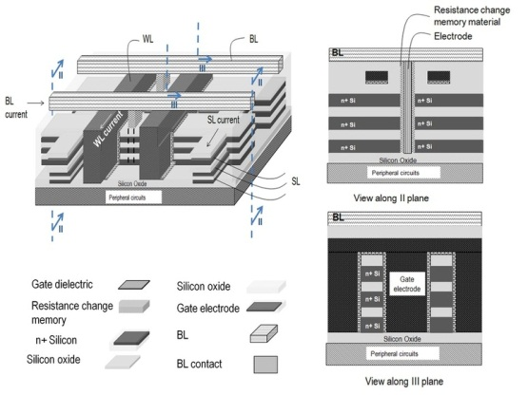
Monolithic 3D Resistive Memories
MonolithIC 3D Inc. Patents Pending
43

Slide 44
Benefits
Benefits
2-3X the density of NAND flash with similar number of litho steps
Single crystal silicon bidirectional transistor selector
Shared litho steps among many memory layers
All layer single crystal silicon provides negligible leakage & dramatically better performance/power
Scalable: Multiple generations of cost-per-bit improvement for same equipment cost and process node: use the same fab for 3 generations
Forestalls next gen litho-tool risk
Density & non-volatility of Flash, but speeds and endurance approaching DRAM
MonolithIC 3D Inc. Patents Pending
44

Slide 45
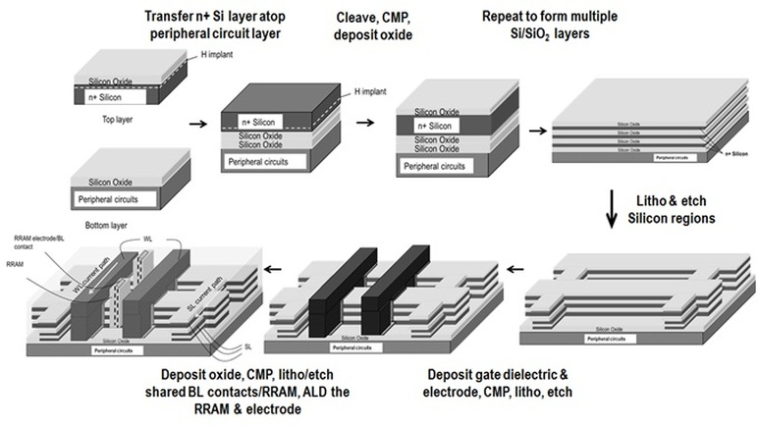
Process Flow

Slide 46
Process Flow
Our 3D resistive memory technology provides:
Shared litho steps to create stacked memory at low cost
Compatible with whatever resistive material you choose
Single crystal Si junctionless transistor selectors allow bipolar operation
MonolithIC 3D Inc. Patents Pending
46

Slide 47
The steps involved in constructing our 3D resistive memory are as follows:
Step 1: Ion-cut is used to transfer a n+ single crystal silicon layer atop the peripheral circuits of the resistive memory as depicted in Fig. 8. Notice how the peripheral circuits are placed under the memory array... this improves the array efficiency and allows smaller-size blocks that offer high performance. Also, the n+ dopants are pre-activated before layer transfer.
Step 2: Using steps similar to Step 1, a silicon-silicon dioxide multilayer sandwich is formed as described in Fig. 9.
Step 3: Using the same litho and etch step, multiple layers of memory are defined as shown in Fig. 10.
Step 4: Gates are formed for multiple levels of memory at the same time as described in Fig. 11.
MonolithIC 3D Inc. Patents Pending
47

Slide 48
The steps involved in constructing our 3D resistive memory are as follows:
Step 5: Using another shared litho step, a via hole is made to multiple levels of memory. A resistive memory element (such as titanium oxide) is deposited following which an electrode is deposited and CMPed (Fig. 12). WL, SL and BL are acronyms for Word Line, Source Line and Bit Line respectively.
Step 6: Bit-lines are then made. Contacts to multiple levels of memory are defined with shared litho steps using a process described in [Tanaka, et al., Symposium on VLSI Technology, 2007]. Fig. 13 and Fig. 14 reveal the structure after this step. Notice how each memory cell consists of a junctionless transistor in series with a RW memory device. Using carefully chosen biases to bit-lines (BLs), word-lines (WLs) and source-lines (SLs), each bit in the memory array can be uniquely addressed.
MonolithIC 3D Inc. Patents Pending
48

Slide 49
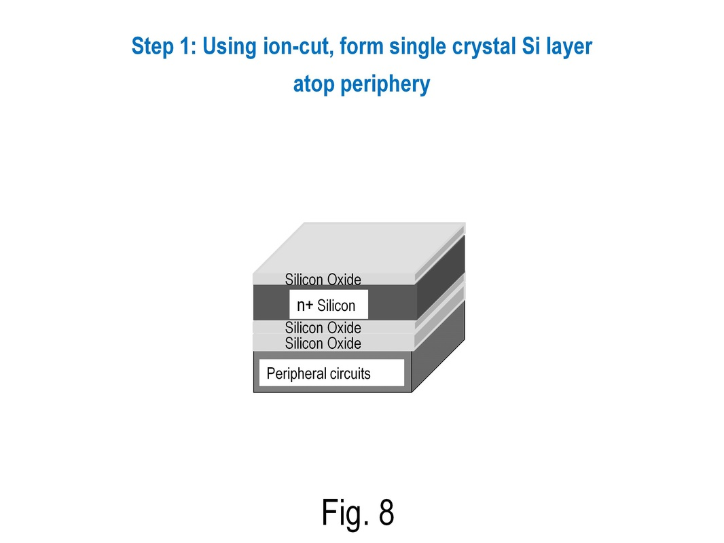
Process Flow
MonolithIC 3D Inc. Patents Pending
49

Slide 50
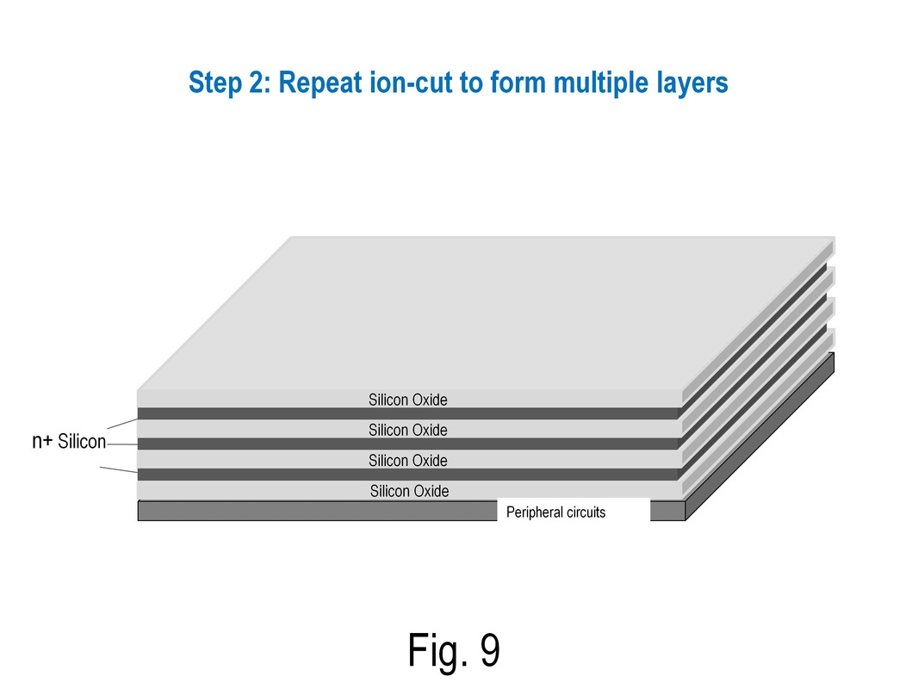
Process Flow
MonolithIC 3D Inc. Patents Pending
50

Slide 51
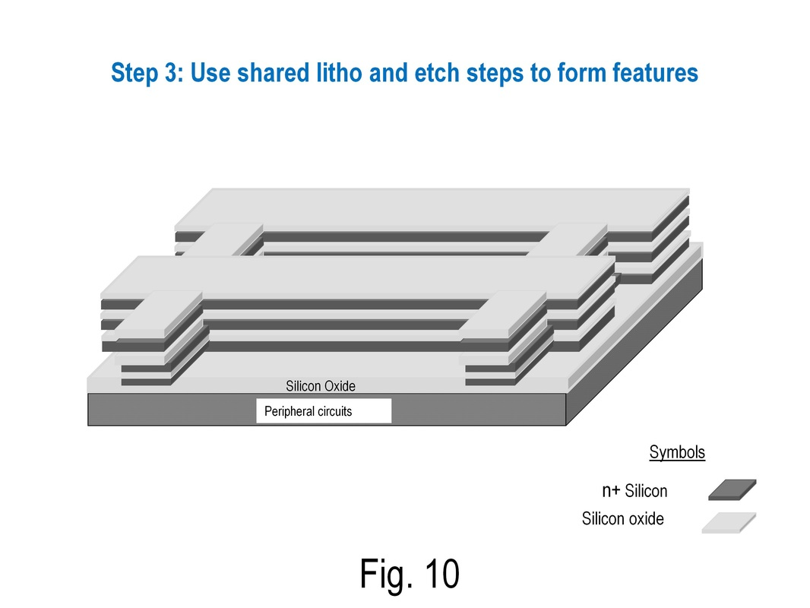
Process Flow
MonolithIC 3D Inc. Patents Pending
51

Slide 52
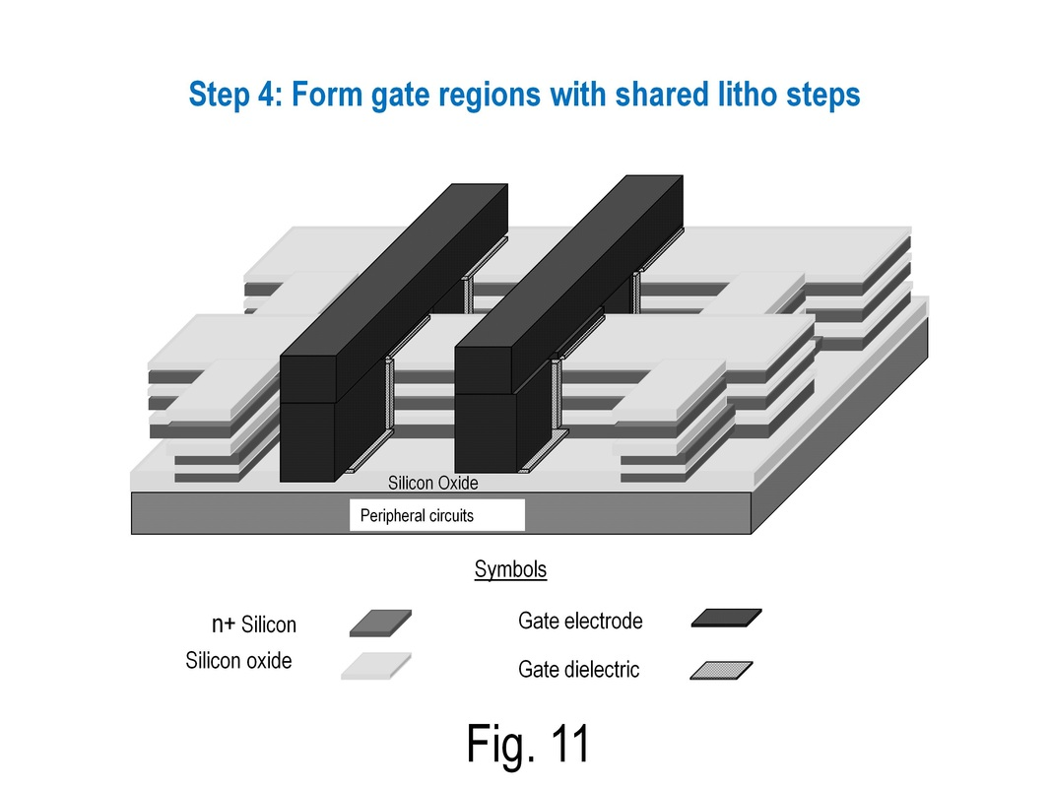
Process Flow
MonolithIC 3D Inc. Patents Pending
52

Slide 53
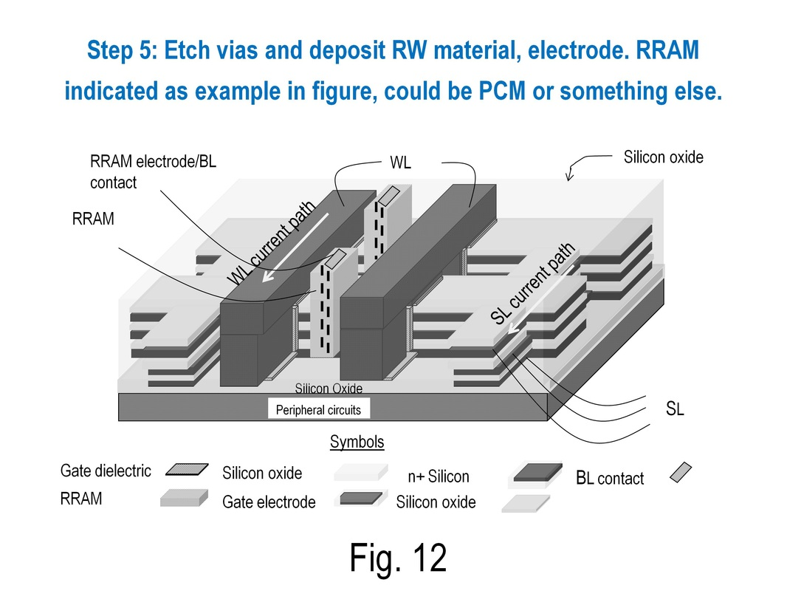
Process Flow
MonolithIC 3D Inc. Patents Pending
53

Slide 54
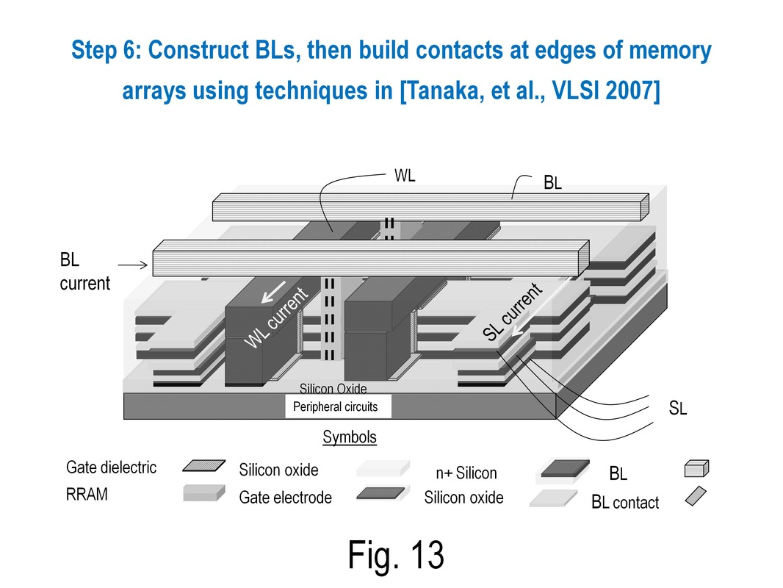
Process Flow
MonolithIC 3D Inc. Patents Pending
54

Slide 55
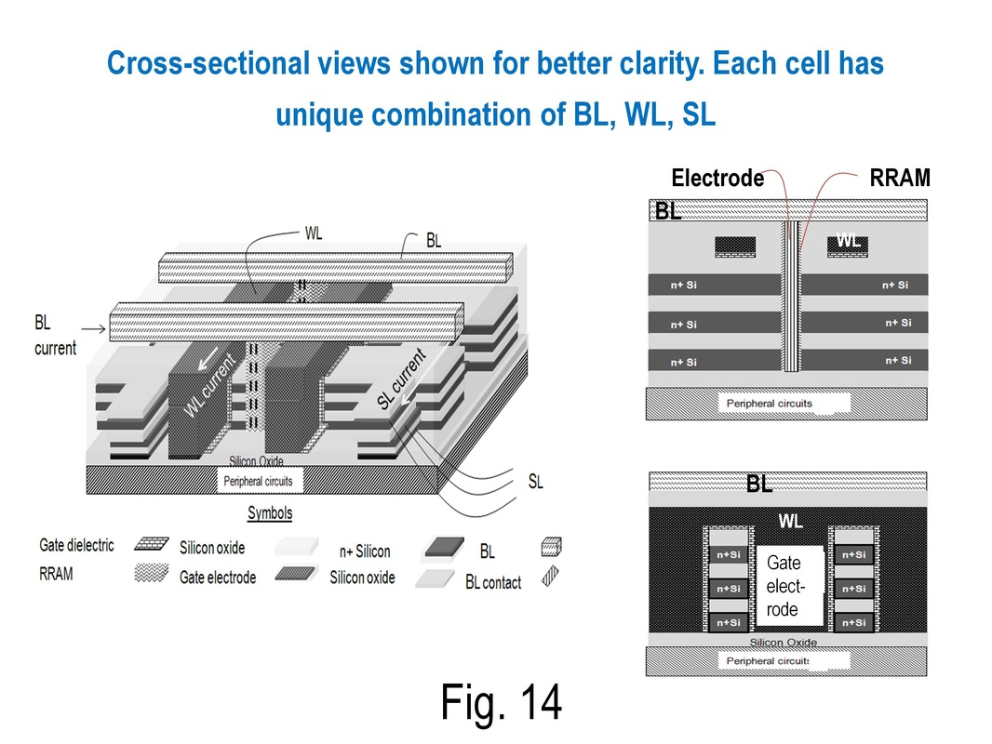
Process Flow
MonolithIC 3D Inc. Patents Pending
55

Slide 56
Array Bias Schemes
Top layer of 3D memory
Bottom layer of 3D memory
1.5V
4V
1.5V
1.5V
4V
1.5V
0V
2.5V
0V
0V
2.5V
0V
3.5V
3.5V
0V
2.5V
0V
0V
2.5V
0V
1V
BL
3.5V
0V
2.5V
0V
0V
2.5V
0V
3.5V
3.5V
SL
Selected cell: Drive current > 40uA as long as voltage drop across select transistor > 1.3V
Un-selected and half-selected cells: Leakage negligible. Huge array sizes possible

Slide 57
Approximate Density Estimations
 | NAND | Poly Diode Selected RRAM | NuRRAM
Cell size | 4F² | 4F² | 18F²
Bits per cell | 2 | 1 | 2
Number of memory levels | 1 | 8 | 10 for 26:1 aspect ratio
Critical Litho steps per level of memory | 4 | ~2 per level | ~5 for 10 levels
Effective density @ 15nm node (memory only) | 2F² and 4 critical litho steps | 0.5F² and 16 critical litho steps | 0.9F² and 5 critical litho steps
MonolithIC RRAM reduces cell size keeping number of litho steps low.
Possible in poly Si also

Slide 58
Comparison of poly diode selected R-RAM and MonolithIC R-RAM
 | Poly Diode Selected RRAM | MonolithIC 3D R-RAM
Effective density | 0.5F² and 16 litho steps | 0.9F² and 5 litho steps
Selector | Two-terminal poly device | Three-terminal single crystal device
Leakage in array | High | Negligible
Bipolar operation possible? | No, pin diode is unidirectional | Yes, transistor selector
Forward current drive | Low | High

Slide 59
Array Specs
Cell size = 9F x 2F/ (10 layers) x (2 bits per cell) ~ 0.9F²
Access time < 5ns for memory element, random access possible
Endurance > 1M cycles
Leakage of unselected cells negligible → bandwidth and power consumption numbers could be much better than NAND flash memory
A high-density NVM with excellent bandwidth, low power consumption, high-endurance and fast random access times!

Slide 60
Summary of MonolithIC R-RAM
Novel 3D resistive memory architecture.
Single crystal Si or poly Si, applicable to many RW materials.
Three-terminal select device (transistor).
0.9F² cell, but just 5 critical litho steps.
  2x density improvement vs. conventional NAND.
  Low number of litho steps vs. today’s 3D RW memories a key advantage.
1M cycles endurance, low latency, high performance due to transistor selector and lack of leakage
→ A Storage-Class Memory solution

Slide 61
© Copyright MonolithIC 3D Inc. , the Next-Generation 3D-IC Company, 2013 - All Rights Reserved, Patents Pending
MonolithIC 3D Inc. Patents Pending
61

