Slide 1


Precision Bonders - A Game Changer for Monolithic 3D
A DISRUPTOR TO THE SEMICONDUCTOR INDUSTRY
Zvi Or-Bach, Brian Cronquist, Zeev Wurman, Israel Beinglass, and Albert Henning
MonolithIC 3D Inc.
MonolithIC 3D™ Inc. Patents Pending
Paper 11.3 IEEE S3S
October 2014
1

Slide 2
Agenda
Motivation – The Escalating Challenges of 2D Scaling
Monolithic 3D as the Solution
Emerging Precision Bonders
  Impact and a Process Flow
Advantages of Monolithic 3DIC

Slide 3
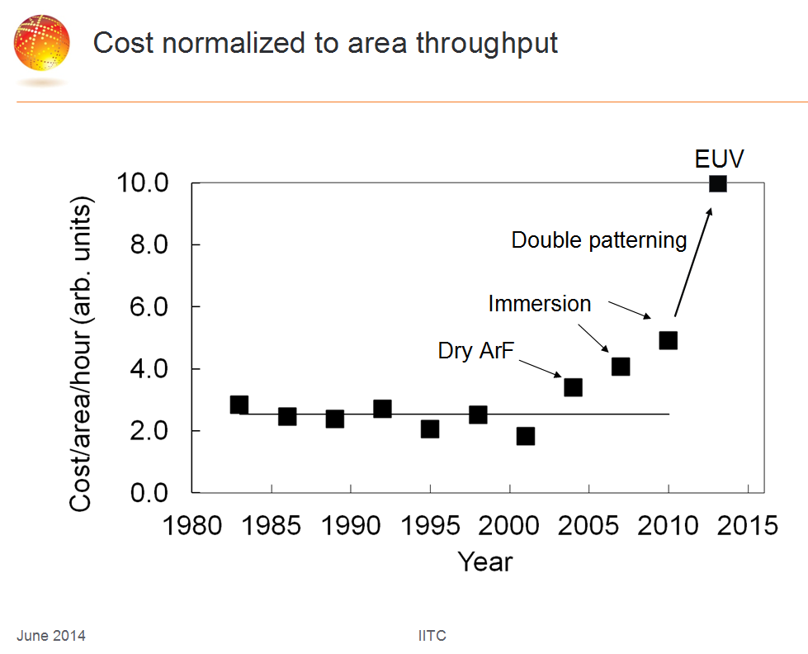

Slide 4
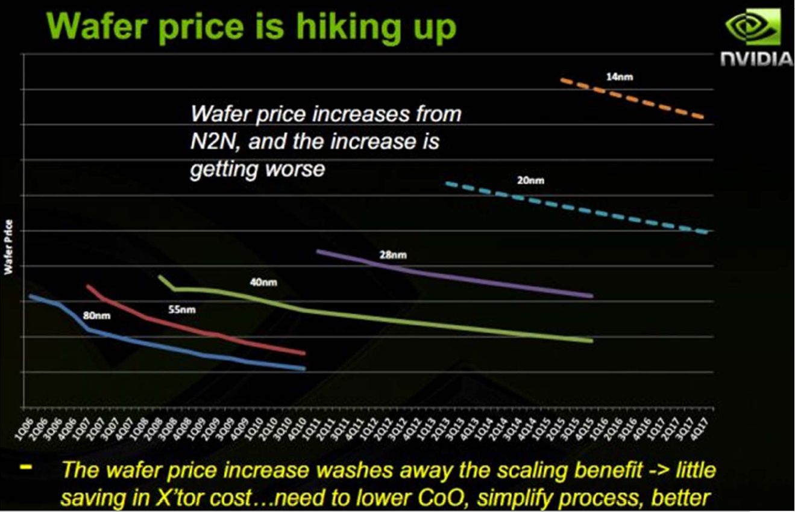

Slide 5
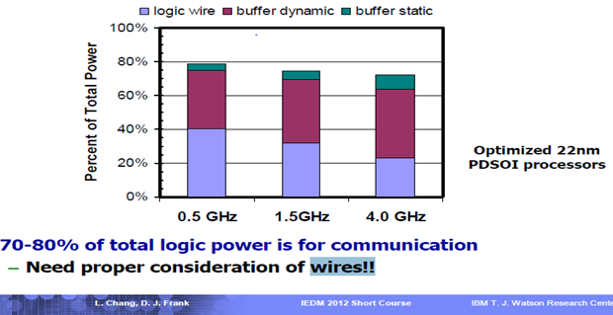
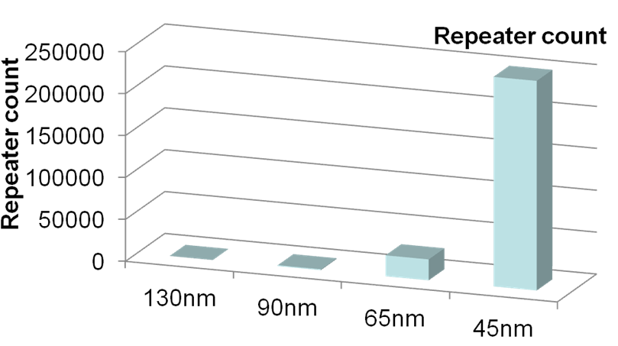
Connectivity Consumes 70-80% of Total Power @ 22nm
Repeaters Consume Exponentially More Power and Area
At 22nm, on-chip connectivity consumes 70-80% of total power
Repeater count increases exponentially
At 45nm, repeaters are > 50% of total leakage
MonolithIC 3D™ Inc. Patents Pending
Source: IBM POWER processors
R. Puri, et al., SRC Interconnect Forum, 2006

Slide 6
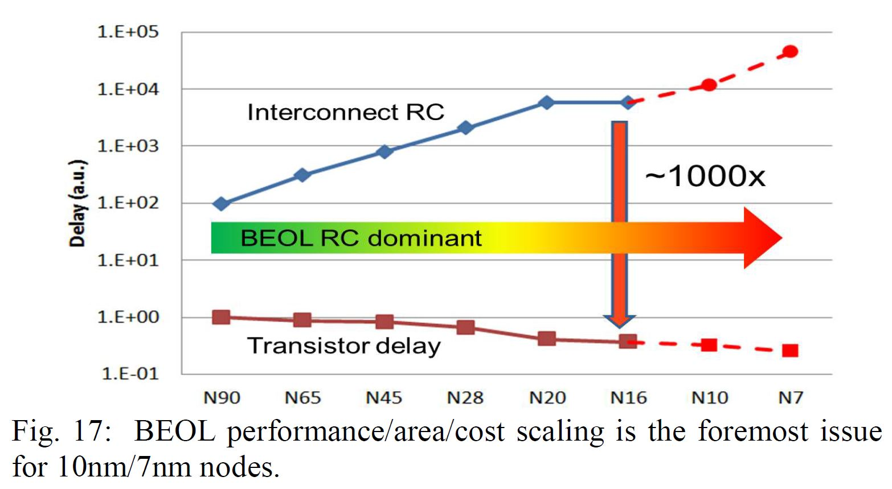
“CEA-Leti Signs Agreement with Qualcomm to Assess Sequential (monolithic)3D Technology”
Business Wire December 08, 2013
“Monolithic 3D (M3D) is an emerging integration technology poised to reduce the gap significantly between transistors and interconnect delays to extend the semiconductor roadmap way beyond the 2D scaling trajectory predicted by Moore’s Law.”
Geoffrey Yeap,
VP of Technology at Qualcomm,
Invited paper, IEDM 2013

Slide 7
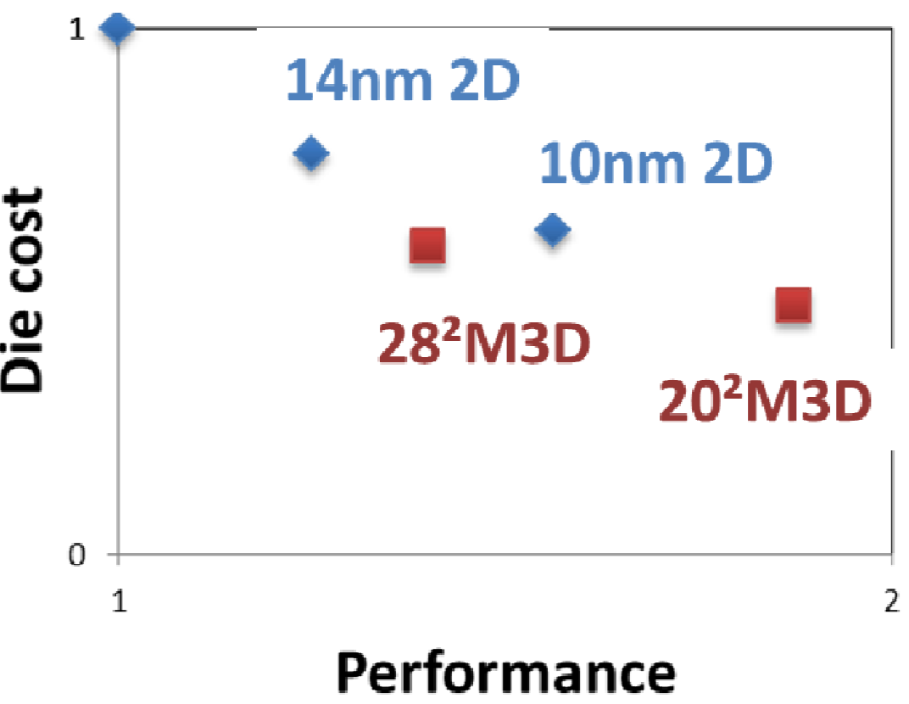

Slide 8
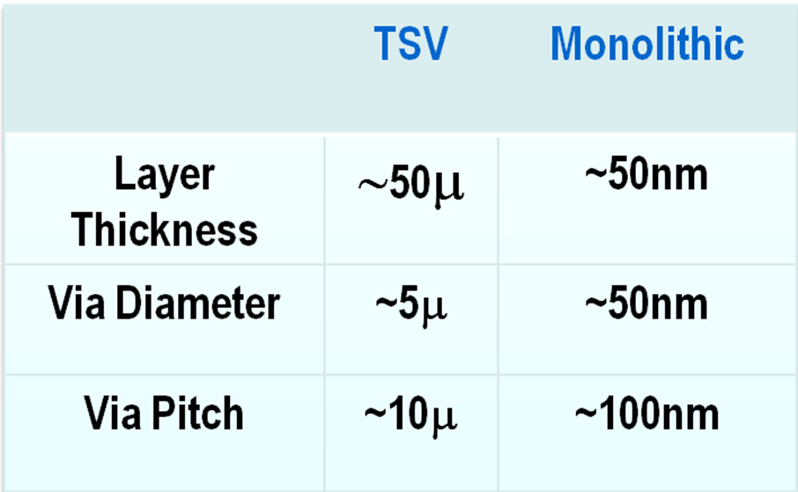
MONOLITHIC
10,000x the Vertical Connectivity of TSV
8

Slide 9
The Monolithic 3D Challenge
Why is it not already in wide use?
Processing on top of copper interconnects should not make the copper interconnect exceed 400ºC
    How to bring mono-crystallized silicon on top at less than 400ºC
    How to fabricate state-of-the-art transistors on top of copper interconnect and keep the interconnect below at less than 400ºC
Misalignment of pre-processed wafer to wafer bonding step is was ~1µm
    How to achieve 100nm or better connection pitch
    How to fabricate thin enough layer for inter-layer vias of ~50nm
9

Slide 10
MonolithIC 3D -
Precision Bonder Flow
RCAT (2009) – Process the high temperature on generic structures prior to ‘smart-cut’, and finish with cold processes – Etch & Depositions
Gate Replacement (2010) (=Gate Last, HKMG) - Process the high temperature on repeating structures prior to ‘smart-cut’, and finish with ‘gate replacement’, cold processes – Etch & Depositions
Laser Annealing (2012) – Use short laser pulse to locally heat and anneal the top layer while protecting the interconnection layers below from the top heat
Precise Bonder (2014) – Use precision bonder and prior techniques such as ‘gate replacement’. Offers low cost flow with minimal R&D

Slide 11
Precision Bonder – Breakthrough
With MonolthIC 3D flow => Easy path to M3D
Alignment challenge is resolved by the use of Precision Bonder and ‘Smart Alignment’
Achieving 10,000x vertical connectivity as the upper strata will be thinner than 100 nm
  Rich vertical connectivity
  High performance – low vertical connection RC
  Low manufacturing costs
Utilizing the existing front-end process !!!
Patents Pending

Slide 12
Use standard flow to process “Stratum 3”
Stratum 3
NMOS
Poly
Oxide
PMOS
STI
~700 µm Donor Wafer
Silicon
Patents Pending
12

Slide 13
Implant H+ 100nm depth for the ion-cut
Ions Implant ~E¹⁷
NMOS
PMOS
STI
~100nm
H+
~700µm Donor Wafer
Silicon
Patents Pending
13

Slide 14
Bond to a carrier-wafer
~700µm Carrier Wafer
Oxide to Oxide bond
STI
H+
~700µm Donor Wafer
Silicon
Patents Pending
14

Slide 15
‘Cut’ (Heating to ~550 ºC) Donor Wafer off
~700µm Carrier Wafer
Transferred ~100nm Layer
- Stratum 3
STI
Silicon
H+
~700µm Donor Wafer
Silicon
Patents Pending
15

Slide 16
CMP and repair the transferred layer
– high temperature is OK !
Silicon
STI
~100nm
Oxide
Bond Oxide ’etch stop’
~700µm
Carrier Wafer
Patents Pending
16

Slide 17
Use standard flow to process “Stratum 2”
Note: High Temperature is OK
High Performance Transistors
Stratum 2
Oxide
Silicon
~100nm Layer
STI
Stratum 3
Oxide
Bond Oxide ’etch stop’
~700µm
Carrier Wafer
Note: A vertical isolation could be formed by reverse bias, deep implant or other methods.
Patents Pending
17

Slide 18
Add at least one interconnect layer
Stratum 2
Silicon
~100nm
Transferred Layer
Oxide
Stratum 3
Bond Oxide ’etch stop’
~700µm
Carrier Wafer
Patents Pending
18

Slide 19
Transfer onto target layer
~700µm
Carrier Wafer
Transferred
Layer (Stratum 2 +Stratum 3)
Oxide-oxide bond
Base Wafer
NMOS
PMOS
Patents Pending
MonolithIC 3D Inc. Patents Pending
19

Slide 20
Remove carrier-wafer (grind, etch)
~700µm
Carrier Wafer
Stratum 3
100 nm
Stratum 2
Oxide-oxide bond
Base Wafer
NMOS
PMOS
Patents Pending
MonolithIC 3D Inc. Patents Pending
20

Slide 21


Gate replacements (when applicable)
Stratum 3
Stratum 2
Oxide-oxide bond
Base Wafer
NMOS
PMOS
Patents Pending
MonolithIC 3D Inc. Patents Pending
21

Slide 22
Monolithic 3D using Precise Bonder
Utilizes existing transistor process
Could help upgrade any fab (leading or trailing)
Provides two additional transistor layers
Very competitive cost structure
Better power, performance, price than a node of scaling at a fraction of the costs !!!
Allows functionality that could not be attained by 2D devices

Slide 23
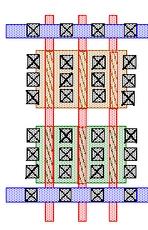
Connect to “Strata 1” using ‘Smart-Alignment’
Landing pad
Oxide
Bottom layer
layout
Top layer
layout
Through-layer connection
‘Smart-Alignment’
Patents Pending
23
Notes:
23
23

Slide 24
Smart Alignment
Through Layer Via connected by landing pad of 200x200 nm²
200nm
200nm

Slide 25
Smart Alignment

Slide 26
‘Smart-Alignment’
‘Smart-Alignment’
Landing pad
Bottom layer
layout
Vertical connection
1 for 200nmx200nm
Vertical connection
200nm/metal pitch ~ 20
for 200nmx200nm
~20X better vertical connectivity
Minimum abstraction for routing
Patents Pending
26
Notes:
26
26

Slide 27
Sequential vs. Parallel
Patents Pending
Some people call monolithic 3D as a ‘sequential process’ in contrast to TSV which is ‘parallel’
Sequential process might over-extend TAT !
By using the MonolithIC + Fusion Bonder flow, a parallel monolithic flow could be constructed

Slide 28
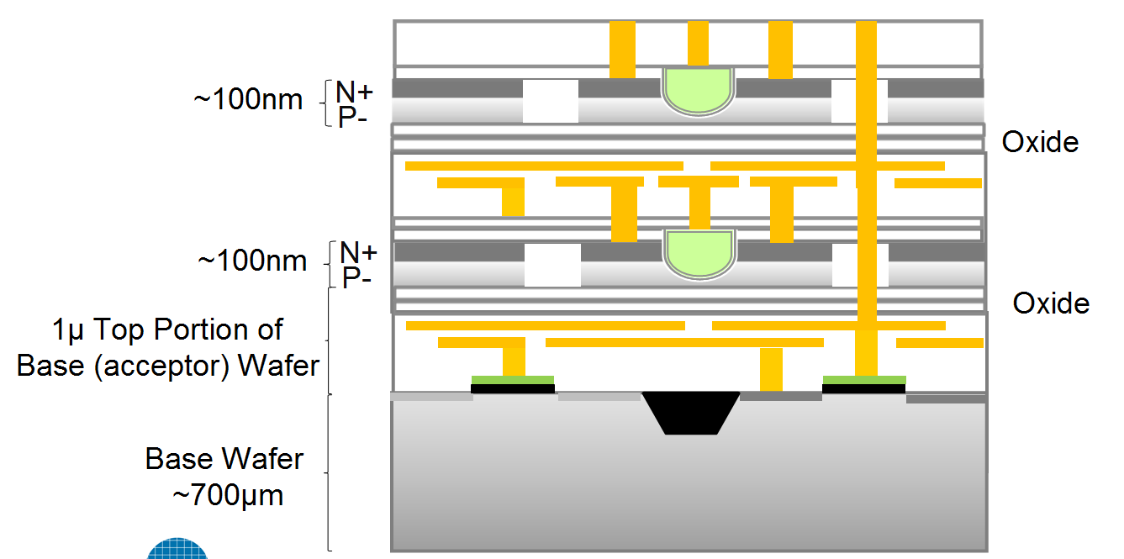
The Operational Thermal Challenge
Poor Heat Conduction
~1 W/mK
Good Heat Conduction
~100 W/mK
Upper tier transistors are fully surrounded by oxide and have no thermal path to remove operational heat away

Slide 29
Cooling Three-Dimensional Integrated Circuits using
Power Delivery Networks (PDNs)
IEDM 2012 Paper
Hai Wei, Tony Wu, Deepak Sekar⁺, Brian Cronquist*, Roger Fabian Pease, Subhasish Mitra
Stanford University, Rambus⁺, Monolithic 3D Inc.*
29

Slide 30
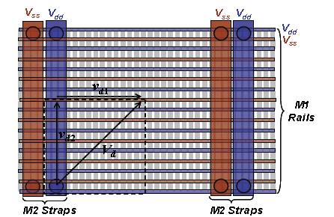





Monolithic 3D Heat Removal Architecture (Achievable with Monolithic 3D vertical interconnect density)
p_{x}
Signal wire
p_{y}
Heat sink
Global power grid shared among multiple device layers, local power grid for each device layer
Local V_{DD} grid architecture shown above
Optimize all cells in library to have low thermal resistance to V_{DD}/V_{SS} lines (local heat sink)
Without Power Grid
With Power Grid
Patents Pending

Slide 31
The Monolithic 3D Advantage
<http://www.monolithic3d.com/3d-ic-edge1.html>
  1. Reduction die size and power – doubling transistor count - Extending Moore’s law
  Monolithic 3D is far more than just an alternative to 0.7x scaling !!!
  2. Significant advantages from using the same fab, design tools
  3. Heterogeneous Integration
  4. Multiple layers Processed Simultaneously - Huge cost reduction (Nx)
  Logic redundancy => 100x integration made possible
  3D FPGA prototype, 2D volume
  7. Enables Modular Design
  8. Naturally upper layers are SOI
  9. Local Interconnect above and below transistor layer
  10. Re-Buffering global interconnect by upper strata
  11. Others
  A. Image sensor with pixel electronics
  B. Micro-display

Slide 32
Some 3D Applications
1T SRAM (Zeno) over Logic
Image sensor with pixel electronics
3D FPGA
Ultra Scale integration using M3DI Redundancy
3D Memory with shared litho.
I/O-SRAM-Logic
3D Based platform with application (/user) specific stratum

Slide 33
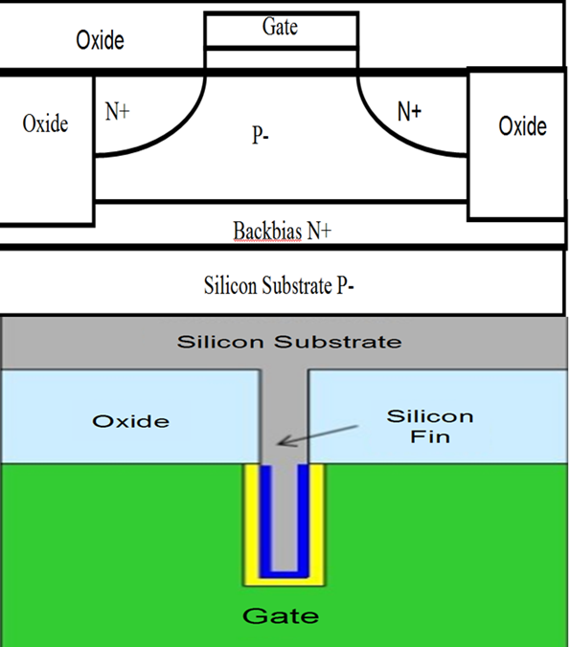
1T SRAM (Zeno) over FinFET

Slide 34
Image Sensor with Pixel Electronics
With rich vertical connectivity, every pixel of an image sensor could have its own pixel electronics underneath
Patents Pending

Slide 35

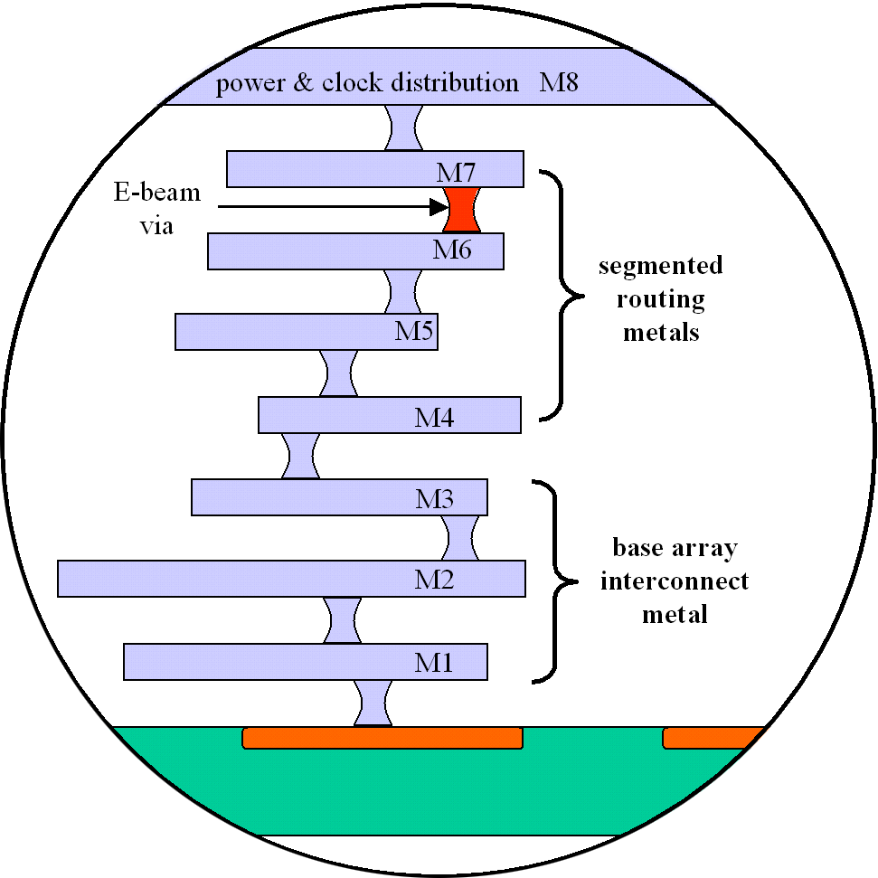
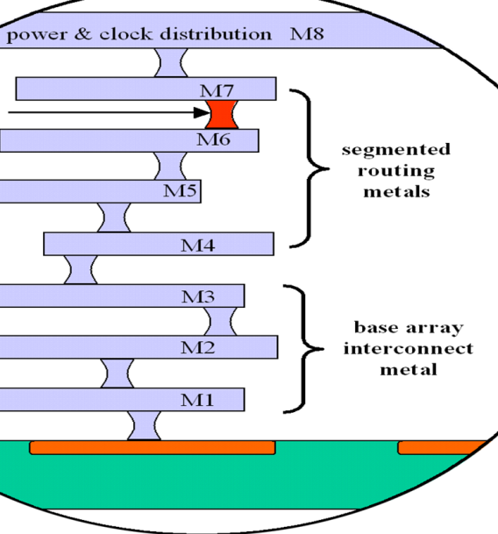
The Twin -
Field-programmable & via-configurable fabric
Prototype Phase-3D
Production Phase-2D
HV Programming Transistors
Vp
Anti-fuses
Prototype volumes
Prototype costs
Std. logic w/mono-3D
OTP till design & functions stabilized
Specific foundry
Production volumes
Production costs
Standard logic process
1-Mask customization
Backup-foundry capable
Patents Pending

Slide 36

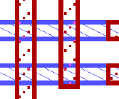
FPGA Achilles’ Heel – PIC (Programmable Interconnect) >30x Area vs. Antifuse/Masked Via
SRAM FPGA connectivity elements @ 45 nm
Via connectivity element @ 45 nm
SRAM
bit
SRAM
bit
Bidi buffer
Area ≈ 4 μ²
Ratio to AF ≈ 100
Via/AF
Via
Pitch - 0.2 μ
.2 x .2= 0.04 μ²
Area: 0.04 μ²
4X
.2μ
4X
SRAM
bit
TS buffer
Area ≈ 2 μ²
Ratio to AF ≈ 50
.2μ
4X
Current FPGAs use primarily pass transistors with a driver.
SRAM
bit
Pass gate
Area ≈ .5 μ²
Ratio to AF ≈ 12
10X
Average area ratio of connectivity element >30
Notes:
36

Slide 37
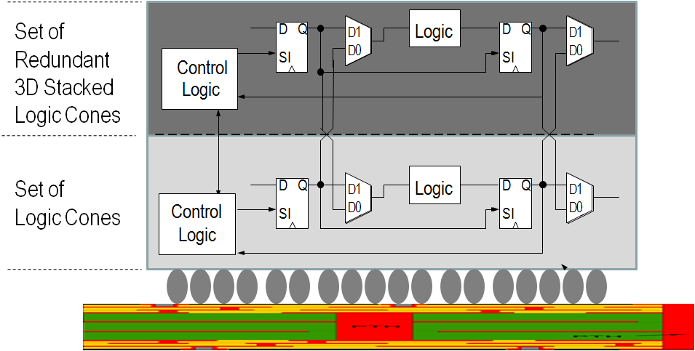
Innovation Enabling ‘Wafer Scale Integration’
– 99.99% Yield with 3D Redundancy
Gene Amdahl -“Wafer scale integration will only work with 99.99% yield, which won’t happen for 100 years” (Source: Wikipedia)
Swap at logic cone granularity
Negligible design and power penalty
Redundant 1μ above, no performance penalty
Server-Farm in a Box
Watson in a Smart Phone
…
Patents Pending

Slide 38
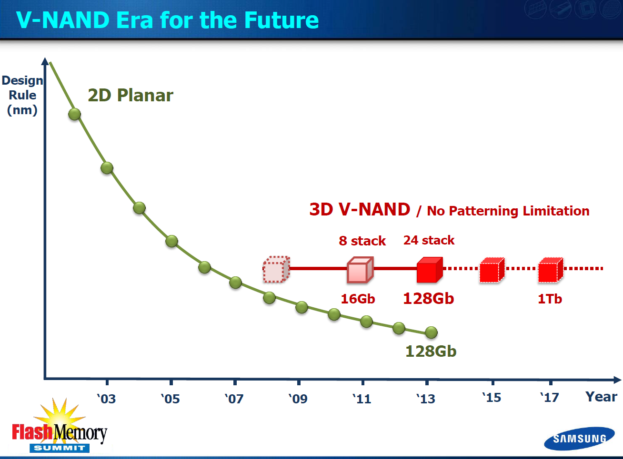
V. Multiple Layers Processed Simultaneously - Huge Cost Reduction (Nx) –”BICS”
Multiple thin layers can be process simultaneously, forming transistors on multiple layers
Cost reduction correlates with number of layers being simultaneously processed (2, 4, 8, 16, 32, 64, 128, ...)

Slide 40
IV. Heterogeneous Integration
Logic, Memories, I/O on different strata
  Optimized process and transistors for the function
  Optimizes the number of metal layers
  Optimizes the litho. (spacers, older node)
Low power, high speed (sequential, combinatorial)
Different crystals – E/O

Slide 41
VII. Enables Modular Design
Platform-based design could evolve to:
  Few layers of generic functions like compute, radios, and one layer of custom design
  Few layers of logic and memories and one layer of FPGA
  ...

Slide 42
Summary
We have reached an inflection point
Monolithic 3D IC – The next generation technology driver
  Breaking News – The barriers are now removed
Multiple simple and practical paths to monolithic 3D exist
Monolithic 3D provides more than just scaling

